Slide 1
Crime management system
From: AnushaB PES1201701061
Swathi PES1201701826
Aishwarya MM PES1201802368
Group no:(18)

Slide 2
Abstract:
The proposed system applies to all Police stations across the country and specifically looks into the subject of Crime Records Management. It is well understood that Crime Prevention, Detection and Conviction of criminals depend on a highly responsive backbone of Information Management. The efficiency of the police function and the effectiveness with which it tackles crime depend on what quality of information it can derive from its existing records and how fast it can have access to it. Initially, the system will be implemented across Cities and Towns and later on, be interlinked so that a Police detective can access information across all records in the state thus helping speedy and successful completion to cases. The project has been planned to be having the view of distributed architecture, with centralized storage of the database. The application for the storage of the data has been planned.

Slide 3
Some of the tables and values
Tables with attributes
Citizen(cname,age,gender,address,bdate,adhar_no,phone)
Police (fname,pid,age,gender,address,ward_no,incharge_id)
Police station(wardno,sname,address,psiname,phone,email)
Criminal(criminal_id,crime_involved,law_id,adhar_no,pid)
Avocation(law_id,section,name,punishment,description)
Complaint(coname,coid,subject,date,details,adhar_no)

Slide 4
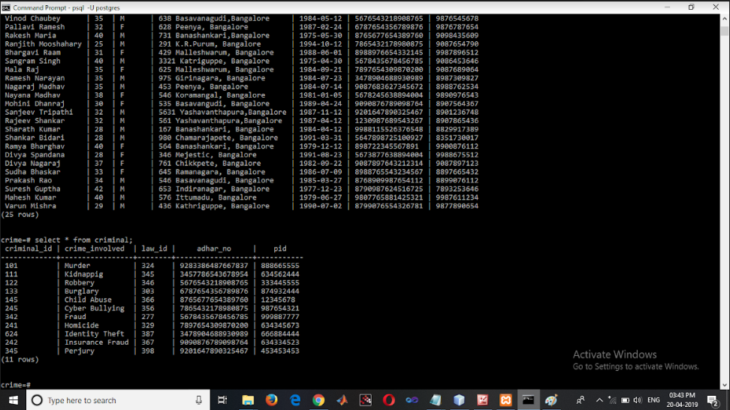
Tables with the following tupples

Slide 5
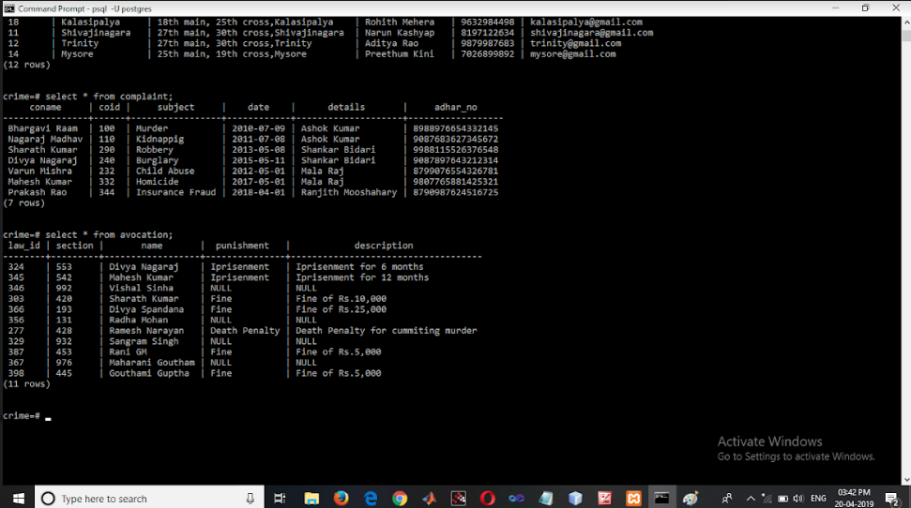

Slide 6
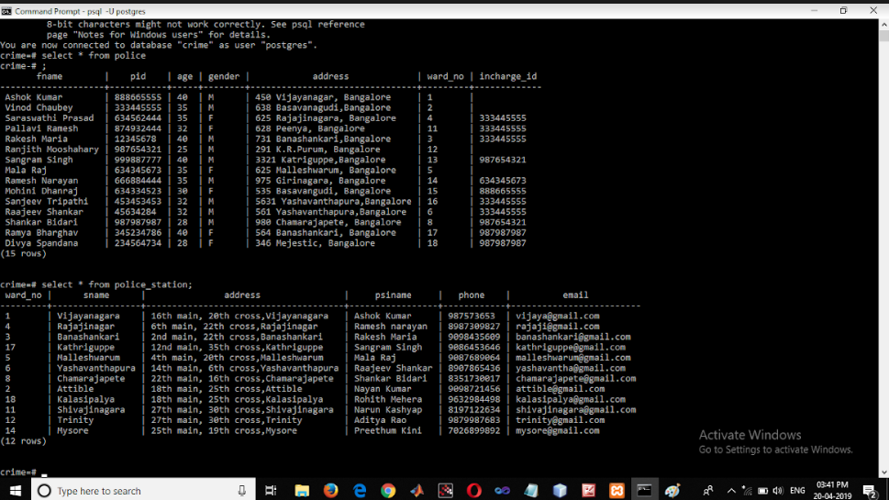

Slide 7
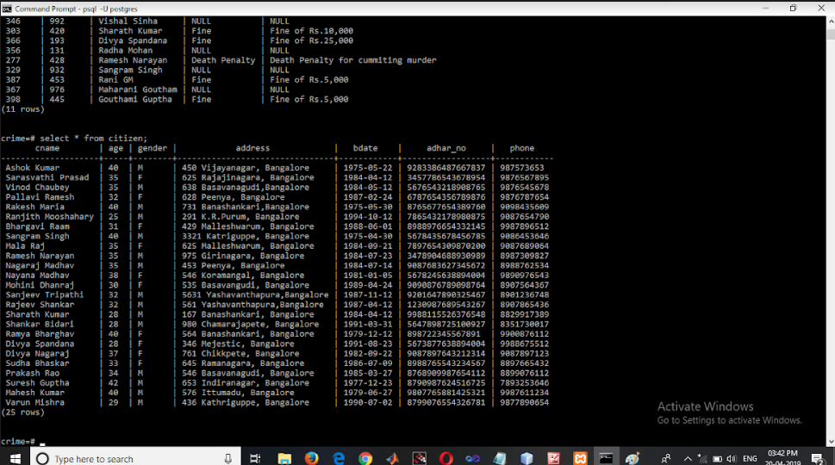

Slide 8
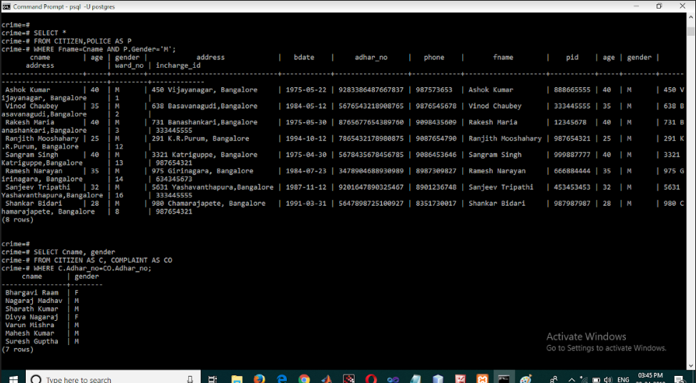
These are the some of the quires:

Slide 9
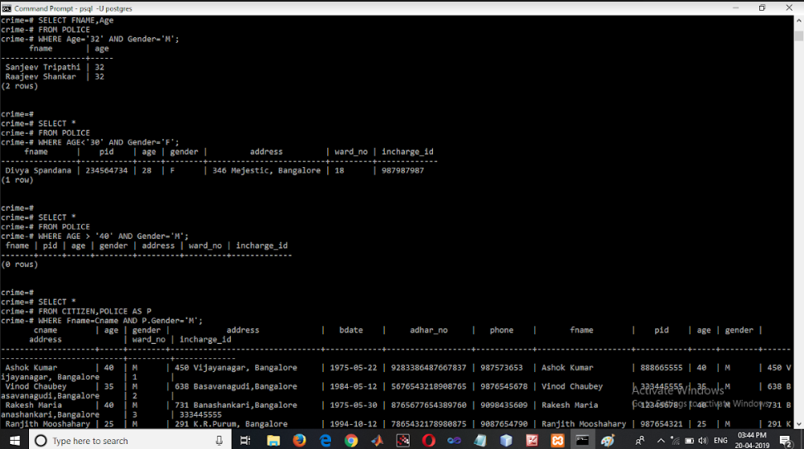

Slide 10
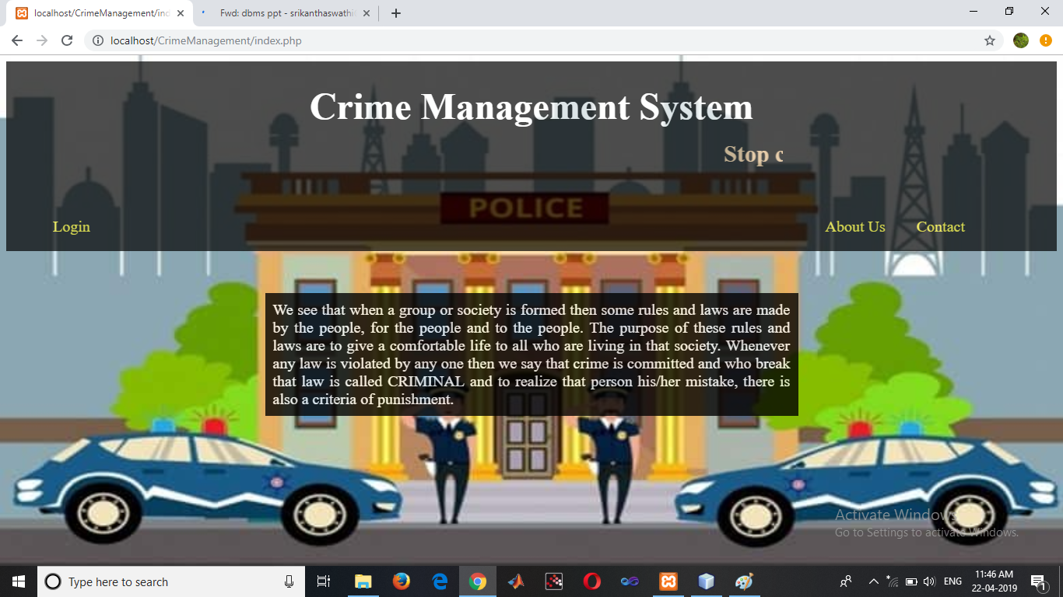
User interface screenshots

Slide 11
